Slide 1
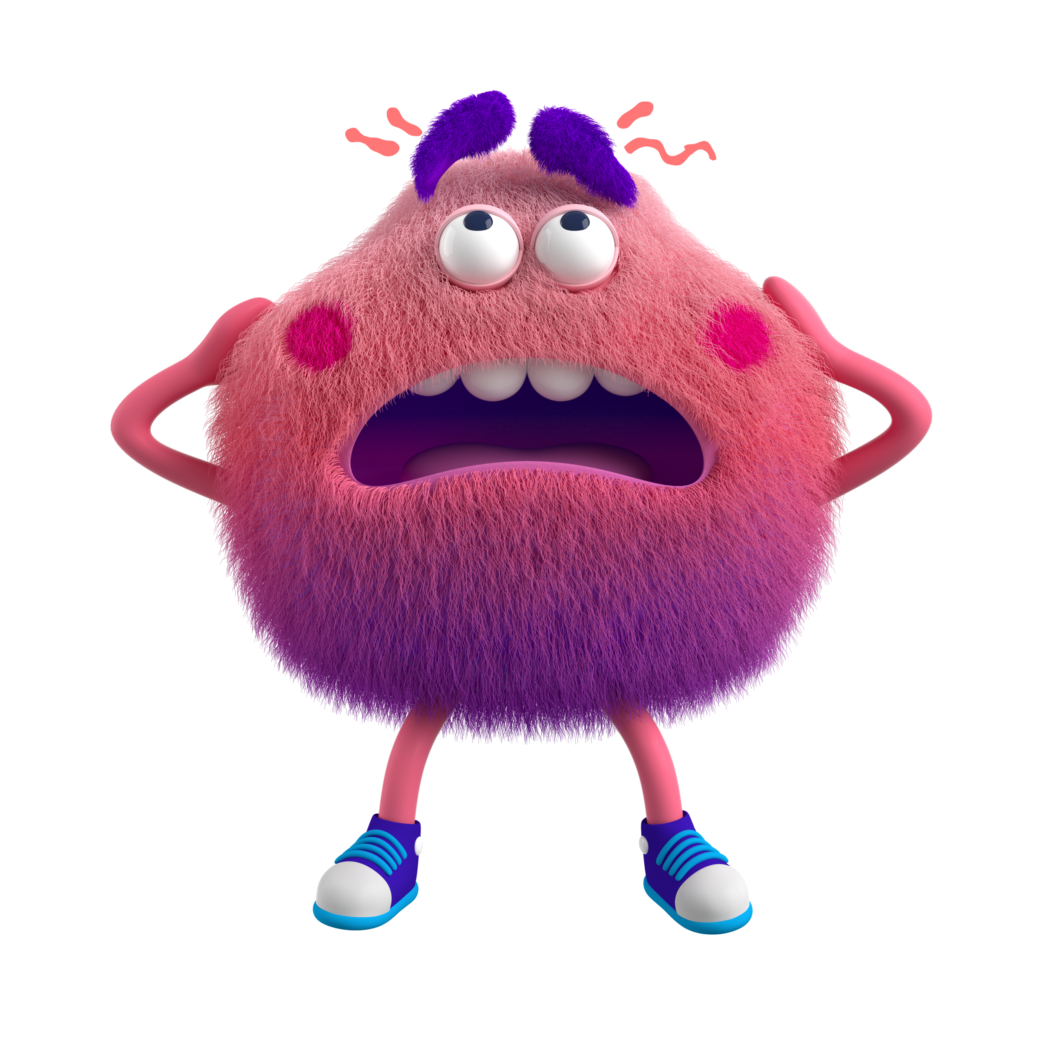
Feeling overwhelmed
Tap into how you're feeling and learn to navigate those emotions

Slide 2

Let’s learn more by watching this video
Sometimes we have big emotions. Noticing and naming those feelings can help us take action to feel better.
What emotions do you notice when you watch this video?
Feeling overwhelmed
2
Notes:
Mental health

Slide 3
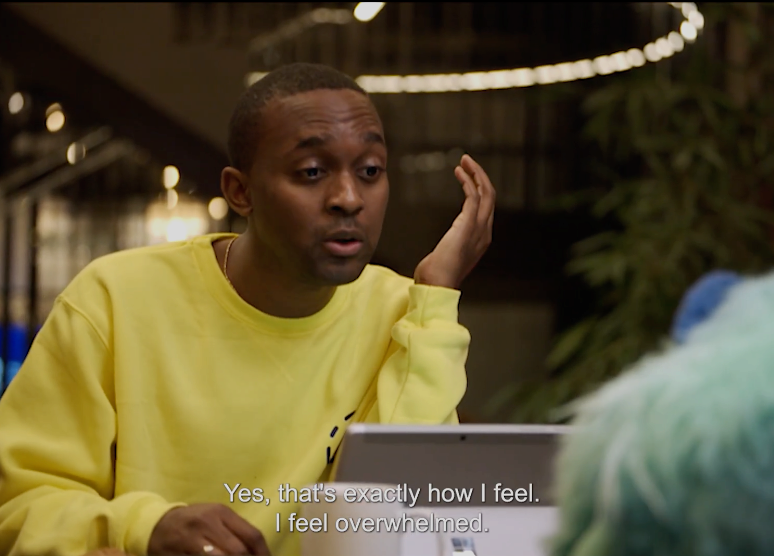
List the emotions you saw in the video
Overwhelmed
Feeling overwhelmed
3

Slide 4

How does the Feelings Monster help Ash learn more about his feelings?
Feeling overwhelmed
4

Slide 5
In your own words, how would you describe feeling "overwhelmed"?
After typing your answer to the left, add your own picture here:
On the Insert tab, select Pictures > Online Pictures.
In the Search Bing box, type overwhelmed.
Select a picture.
Select Insert.
Move and resize your picture so that it covers this box.
Feeling overwhelmed
5

Slide 6

What do you notice when you're getting overwhelmed? List some of the signs
1.
2.
3.
4.
5.
Feeling overwhelmed
6

Slide 7
How can slowing down help when you're feeling overwhelmed?
Feeling overwhelmed
7

Slide 8
How can talking about your emotions with a friend help?

Slide 9
How can talking about your emotions with your teacher help?
Feeling overwhelmed
9

Slide 10
Teachers: How to use this template
Emotional literacy is the ability to notice, name, and interpret our emotions. Just like other skills, emotional literacy can be developed with education and practice.
This template is perfect for accompanying lesson plans and activities centered around feelings & emotions. Use in combination with Reflect, your free check-in app from Microsoft Teams, or as a stand-alone activity.
Use this template to help students:
Notice their emotions
Name their emotions
Interpret their emotions
Learn all about Reflect.
Need more help? Visit Reflect in Teams for support.

